Slide 1

Key Performance Indicators
28th September, 2019
Problem Statement
How to grow Better, Smarter and Faster
Key Performance Indicators
Fastest Way-
Analytical Control Over Business
Make Sense of Business Data
Better Predictions
A. Real Time KPI Visualization
Data measurement and analysis are essential to attaining superior performance in every facet of a business.
B. Enhanced Market Competency
C. Proactive Business Process Management
D. Demand Sensing from Data
E. Accurate Customer Profiling
F. Better Tracking

Slide 2
Introduction

Slide 3
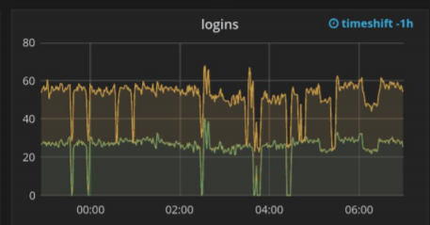
Smarter Business Controls
Questions In Shipping Business
Are facilities having enough storage space for peak?
Do we have to add more conveyor belts and sorter bins for expected volume?
Do we need more Autostores in specific regions of world?
Do we need better Lobor Mangement Strategies at specific regions during specific times, can we place predictions on it?
Which product or regions are having more Returns flow?
How much finance is impacted of product failure?
Can we predict a product failure and place necessary action plan against it?
Can we notify in prior to customers about expected delivery failures?
Can we notify in prior about early deliveries and bring in customer satisfaction?
Can we get information on weather & risk conditions impact on business?
Which carriers are better performing and would leverage PB3D or PB1D plan?
Which regions have better carrier services to launch PB3D or PB1D plan?
Can we reuse USPS or PB carrier services at times to bring in Return Parcels after deliveries at USPS?
Can we analyse any aspect of business like financial, commercials, InfoTech Systems, Carriers, Autostores, Products lifecycle, Supply Chain Risk Managements and decisions, Regional Profits and Loss, Most Value Added Customers, Customers Engagement Plans Performance.
Can we help customers know their business with us from their perspective and empower more business.
A. Time Series Analysis
Manifest v/s Delivery
Peak Readiness
InfoTech Systems Performance
Predictions
B. Services Analysis
C. Deliveries and Returns Volume Analysis
Answer is YES

Slide 4
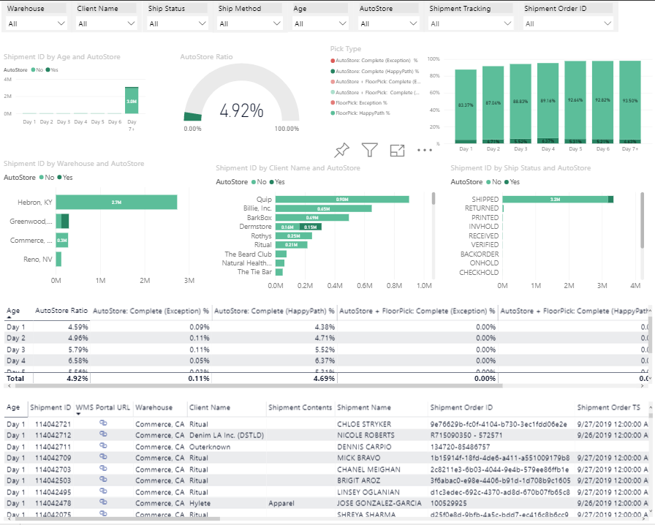
AutoStore Vs FloorPick Shipment
v

Slide 5
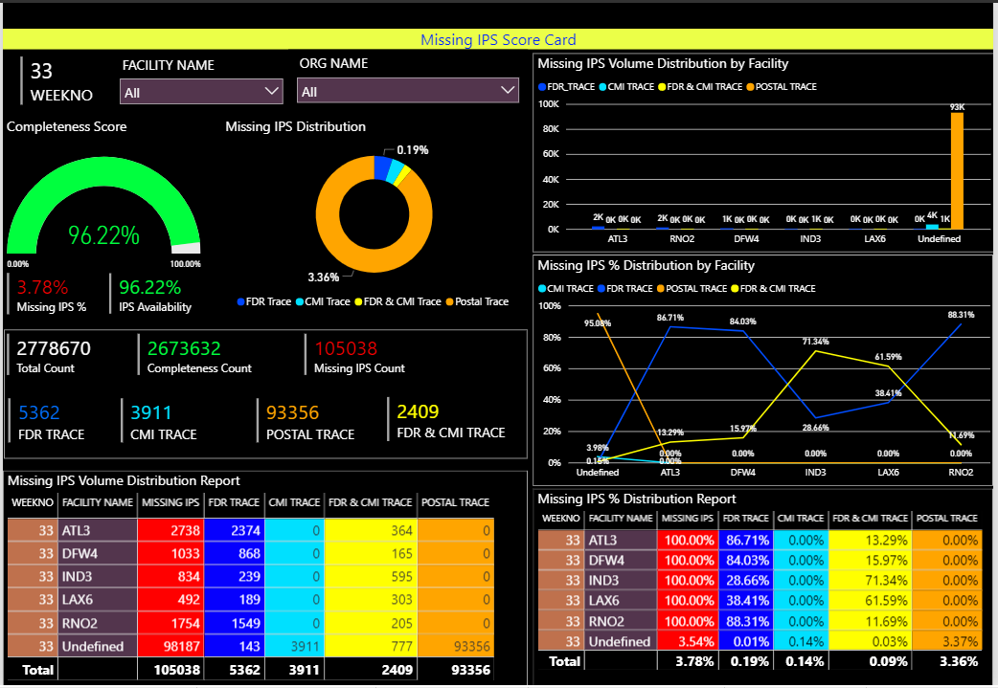
Chain of Custody - Missing IPS Score Card
v

Slide 6
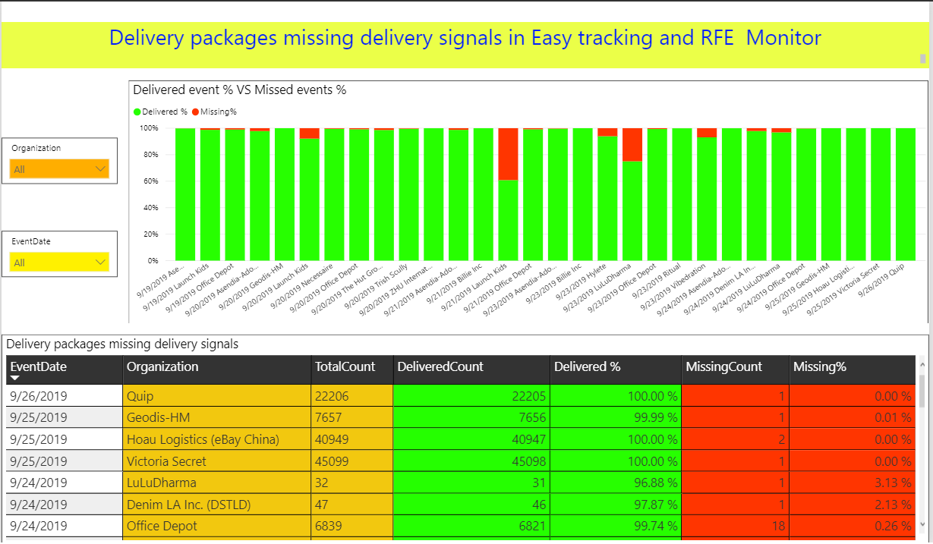
Effective Tracking - Packages Missing Delivery Signals
v

Slide 7
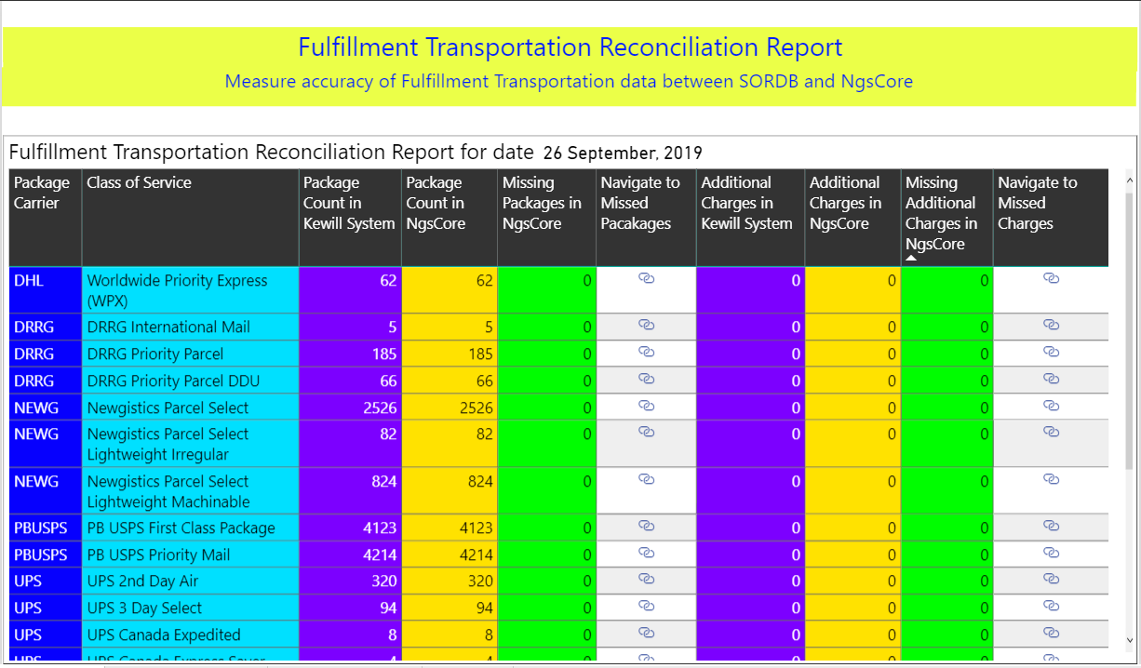
Carrier Services Analysis
v

Slide 8
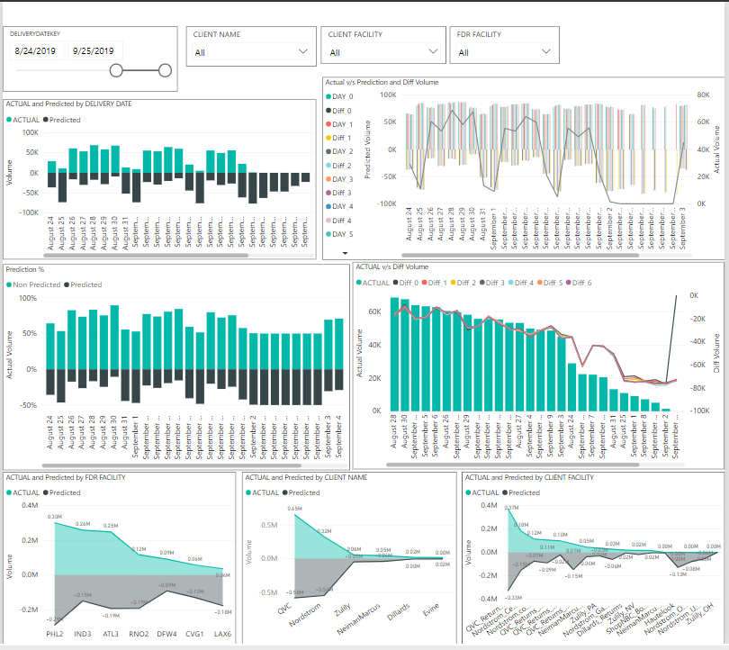
Return Volume Prediction
v

Slide 9
Real Time Analytics provides.. Smarter, Better and Faster Business Insights
Deming once famously quoted, “In God we trust, all others must bring data.” If oil was the fuel that propelled the Third Industrial revolution, data is the new fuel that will run the Fourth Industrial Revolution.

Slide 10
Thank You

